Slide 1
Relationships within Triangles
Geometry
Chapter 6

Slide 2
This Slideshow was developed to accompany the textbook
  Big Ideas Geometry
  By Larson and Boswell
  2022 K12 (National Geographic/Cengage)
Some examples and diagrams are taken from the textbook.
Slides created by
Richard Wright, Andrews Academy
rwright@andrews.edu

Slide 3
6.1 Perpendicular and Angle Bisectors
After this lesson…
• I can identify a perpendicular bisector and an angle bisector.
• I can use theorems about bisectors to find measures in figures.
• I can write equations of perpendicular bisectors.

Slide 4
6.1 Perpendicular and Angle Bisectors
Perpendicular Bisector
  Segment that is perpendicular to and bisects a segment
Perpendicular Bisector Theorem
If a point is on the perpendicular bisector of a segment, then it is equidistant from the endpoints of the segment
Converse of the Perpendicular Bisector Theorem
If a point is equidistant from the endpoints of a segment, then it is on the perpendicular bisector of the segment

Slide 5
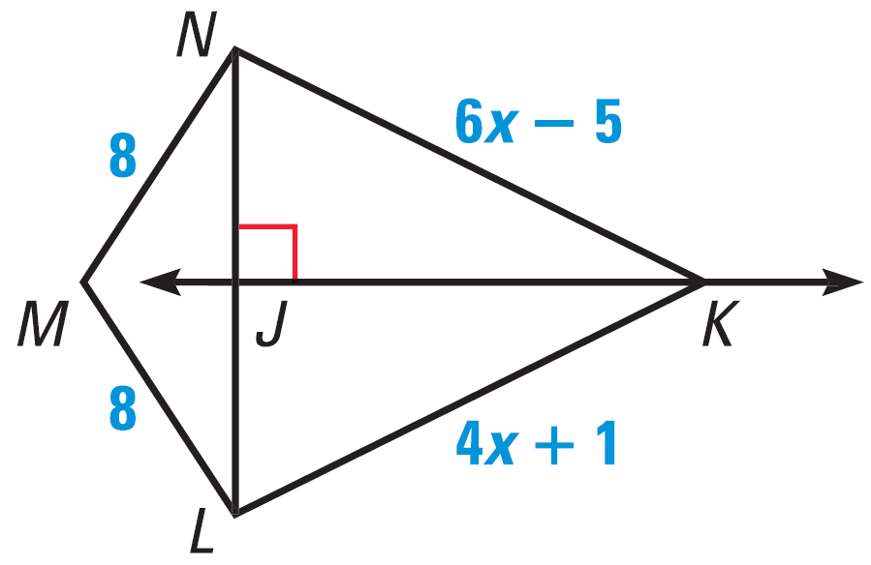

6.1 Perpendicular and Angle Bisectors
In the diagram, $\overset{⃡}{JK}$ is the perpendicular bisector of $\overline{NL}$.
Find NK.
Explain why M is on $\overset{⃡}{JK}$.
Try #6
Notes:
Since JK is ⊥ bisector, then NK = LK (⊥ bisector theorem).
$$6x−5=4x+1 → 2x−5=1 → 2x=6 → x=3$$
Find NK: $6x−5 → 6\left(3\right)−5=13$
Since MN = ML, M is equidistant from each end of NL. Thus by then Converse of the Perpendicular Bisector Theorem, M is on the perpendicular bisector.

Slide 6
6.1 Perpendicular and Angle Bisectors
Angle Bisector
  Ray that bisects an angle
Angle Bisector Theorem
If a point is on the angle bisector, then it is equidistant from the sides of the angle
Converse of the Angle Bisector Theorem
If a point is equidistant from the sides of an angle, then it is on the angle bisector

Slide 7
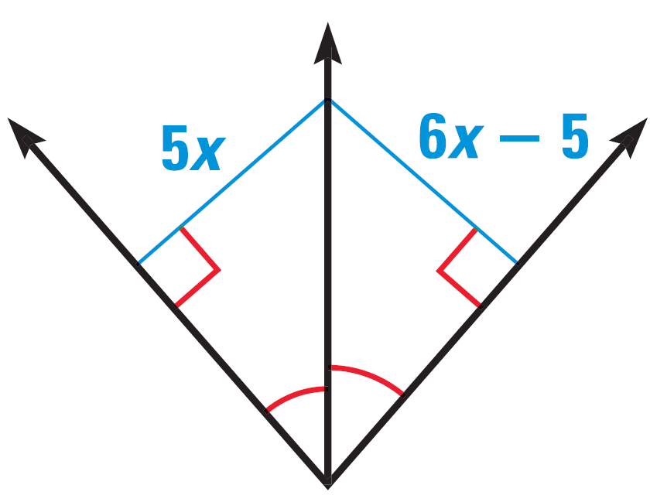
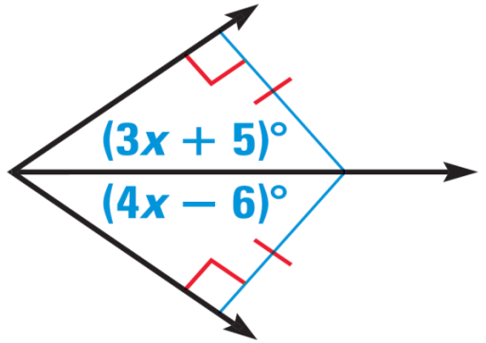
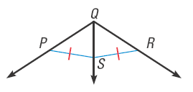

6.1 Perpendicular and Angle Bisectors
Find the value of x.
Try #14
Do you have enough information to conclude that $\vec{QS}$ bisects ∠PQR?
Try #10
Notes:
$$3x+5=4x−6 → 5=x−6 → x=11$$
$$5x=6x−5 → −x=−5 → x=5$$
No, you need to know that SP ⊥ QP and SR ⊥ QR

Slide 8
6.1 Perpendicular and Angle Bisectors
Write Equations of Perpendicular Bisector
Find midpoint
Find slope
Find ⊥ slope
Write equation using slope from #3 and point from #1
Write the perpendicular bisector of a segment with endpoints D(5, −1) and E(−11, 3)
Try #20
Notes:
Midpoint: $M=\left(\frac{x_{1}+x_{2}}{2},\frac{y_{1}+y_{2}}{2}\right)→\left(\frac{5+\left(−11\right)}{2},\frac{−1+3}{2}\right)→\left(−3, 1\right)$
Slope: $m=\frac{y_{2}−y_{1}}{x_{2}−x_{1}}→\frac{3−\left(−1\right)}{−11−5}=\frac{4}{−16}=−\frac{1}{4}$
⊥ Slope: $m=4$
Equation:
$y=mx+b$
$1=4\left(−3\right)+b$
$1=−12+b$
$13=b$
$y=4x+13$

Slide 9
6.2 Bisectors of Triangles
After this lesson…
• I can find the circumcenter and incenter of a triangle.
• I can use points of concurrency to solve real-life problems.

Slide 10
6.2 Bisectors of Triangles
Find the perpendicular bisectors of a triangle
Cut out a triangle
Fold each vertex to each other vertex
  The three folds are the perpendicular bisectors
What do you notice?
  Perpendicular bisectors meet at one point
Measure the distance from the meeting point to each vertex
What do you notice?
  The distances are equal

Slide 11
6.2 Bisectors of Triangles
Concurrent
  Several lines that intersect at same point (point of concurrency)
Concurrency of Perpendicular Bisectors of a Triangle
The perpendicular bisectors of a triangle intersect at a point that is equidistant from the vertices of a triangle

Slide 12
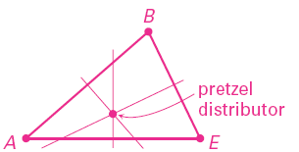
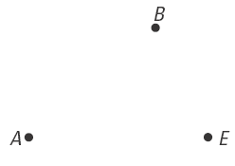
6.2 Bisectors of Triangles
Hot pretzels are sold from store at A, B, and E. Where could the pretzel distributor be located if it is equidistant from those three points?
Try #1, 4

Slide 13
6.2 Bisectors of Triangles
Circumcenter
  The point of concurrency of the perpendicular bisectors of a triangle.
  If a circle was circumscribed around a triangle, the circumcenter would also be the center of the circle.

Slide 14
6.2 Bisectors of Triangles
Concurrency of Angle Bisectors of a Triangle
The angle bisectors of a triangle intersect at a point that is equidistant from the sides of a triangle
Incenter
  Point of concurrency of the angle bisectors of a triangle
  If a circle was inscribed in a triangle, the incenter would also be the center of the circle.

Slide 15
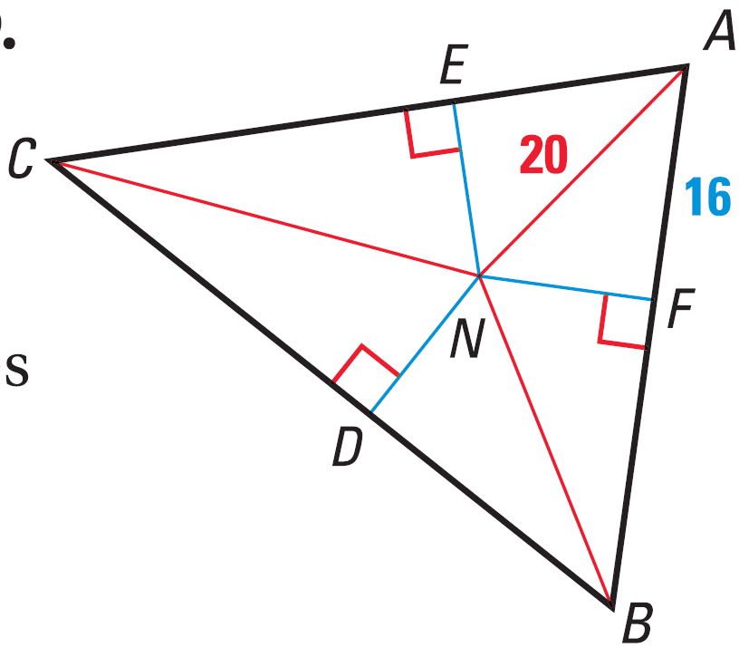
6.2 Bisectors of Triangles
N is the incenter. Find EN.
Try #6, 12
Notes:
Find NF by using the Pythagorean theorem.
$${16}^{2}+NF^{2}={20}^{2} → 256+NF^{2}=400 → NF^{2}=144 → NF=12$$
Since N is the incenter, NF = EN = 12

Slide 16
6.3 Medians and Altitudes of Triangles
After this lesson…
• I can find the centroid of a triangle.
• I can find the orthocenter of a triangle.

Slide 17
6.3 Medians and Altitudes of Triangles
Median
  Segment that connects a vertex to a midpoint of side of a triangle.
  Point of concurrency is called the centroid.
  The centroid is the balance point.
Concurrency of Medians of a Triangle
The medians of a triangle intersect at a point that is two thirds of the distance from each vertex to the midpoints of the opposite side.

Slide 18
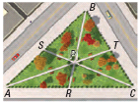
6.3 Medians and Altitudes of Triangles
Each path goes from the midpoint of one edge to the opposite corner. The paths meet at P.
If SC = 2100 ft, find PS and PC.
If BT = 1000 ft, find TC and BC.
If PT = 800 ft, find PA and TA.
Try #2, 6
Notes:
$$PC=\frac{2}{3}SC → PC=\frac{2}{3}(2100)=1400 ft → PS=700 ft$$
$$T is midpoint of BC. TC=1000 ft, BC=2000 ft$$
$$PT=\frac{1}{3}TA → 800=\frac{1}{3}TA → 2400 ft=TA, PA=1600 ft$$

Slide 19
6.3 Medians and Altitudes of Triangles
Find the coordinates of the centroid of △ABC with vertices A(0, 4),
B(−4, −2), and C(7, 1).
Try #16
Notes:
Graph the points
Find the midpoints of each side
$M_{AB}=\left(\frac{0+\left(−4\right)}{2},\frac{4+\left(−2\right)}{2}\right)=\left(−2, 1\right)$
$M_{BC}=\left(\frac{−4+7}{2},\frac{−2+1}{2}\right)=\left(\frac{3}{2},−\frac{1}{2}\right)$
$M_{AC}=\left(\frac{0+7}{2},\frac{4+1}{2}\right)=\left(\frac{7}{2},\frac{5}{2}\right)$
Connect each midpoint with the opposite vertex
The centroid is the intersection
(1, 1)

Slide 20
6.3 Medians and Altitudes of Triangles
Altitudes
  Segment from a vertex and perpendicular to the opposite side of a triangle.
  Point of concurrency is called the orthocenter.
  Acute Δ → orthocenter inside triangle
  Right Δ → orthocenter on right angle of triangle
  Obtuse Δ → orthocenter outside of triangle
Concurrency of Altitudes of a Triangle
The lines containing the altitudes of a triangle are concurrent.
Notes:
There is nothing terribly interesting about the orthocenter.
In an acute triangle, the orthocenter is inside the triangle.
In a right triangle, the orthocenter is on the triangle at the right angle.
In an obtuse triangle, the orthocenter is outside of the triangle.

Slide 21
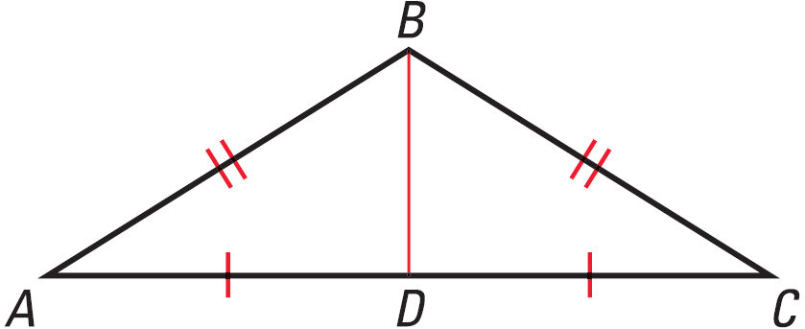
6.3 Medians and Altitudes of Triangles
Find the orthocenter.
Try #18
Notes:
Draw the other two altitudes (from A and C). They will be outside the triangle

Slide 22
6.3 Medians and Altitudes of Triangles
In an isosceles triangle, the perpendicular bisector, angle bisector, median, and altitude from the vertex angle are all the same segment.

Slide 23

6.3 Medians and Altitudes of Triangles
Given: ΔABC is isosceles, $\overline{BD}$ is a median
Prove: $\overline{BD}$ is an angle bisector
Statements
Reasons
Try #26
Notes:
ΔABC is isosceles, BD is a median (given)
BA ≅ BC (def. Isosceles)
AD ≅ DC (def. Median)
BD ≅ BD (reflexive)
ΔABD ≅ ΔCBD (SSS)
∠ABD ≅ ∠CBD (def ≅ Δ) (CPCTC)
BD is an angle bisector (def angle bisector)

Slide 24
6.4 The Triangle Midsegment Theorem
After this lesson…
• I can use midsegments of triangles in the coordinate plane to solve problems.
• I can solve real-life problems involving midsegments.

Slide 25
6.4 The Triangle Midsegment Theorem
Draw a triangle in your notes
Find the midpoints of two of the sides using a ruler
Connect the midpoints of the two sides with a segment
Measure the segment and the third side
What do you notice?
What else do you notice about those two segments?
Notes:
Length should be ½
They should be parallel

Slide 26
6.4 The Triangle Midsegment Theorem
Midsegment of a Triangle
  Segment that connects the midpoints of two sides of a triangle
Midsegment Theorem
The midsegment of a triangle is parallel to the third side and is half as long as that side.

Slide 27

6.4 The Triangle Midsegment Theorem
In △RST, show that midsegment $\overline{MN}$ is parallel to $\overline{RS}$ and that
$MN=\frac{1}{2}RS$.
Try #2
Notes:
Parallel (slopes):
$$m_{MN}=\frac{2−0}{3−1}=1$$
$$m_{RS}=\frac{5−1}{2−\left(−2\right)}=1$$
Distance:
$$MN=\sqrt{{\left(3−1\right)}^{2}+{\left(2−0\right)}^{2}}=2\sqrt{2}$$
$$RS=\sqrt{{\left(2−\left(−2\right)\right)}^{2}+{\left(5−1\right)}^{2}}=4\sqrt{2}$$

Slide 28
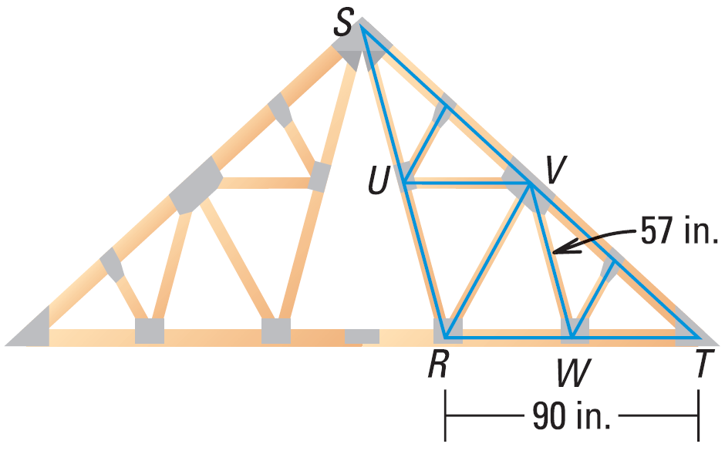
6.4 The Triangle Midsegment Theorem
Name the midsegments.
Draw the third midsegment.
Let UW be 81 inches. Find VS.
Try #8, 10
Notes:
UV, WV
UW
UW = ½ ST
VT = ½ ST
UW = VT = 81

Slide 29

6.4 The Triangle Midsegment Theorem
Given: $CF=FB$ and $CD=DA$
Prove: $\overline{DF}∥\overline{AB}$
Statements
Reasons
Try #6
Notes:
CF = FB, CD = DA (given)
F is midpoint of CB, D is midpoint of AC (def. Midpoint)
DF is midsegment (def. Midsegment)
DF ∥ AB (Midsegment Theorem)

Slide 30
6.5 Indirect Proof and Inequalities in One Triangle
After this lesson…
• I can write indirect proofs.
• I can order the angles of a triangle given the side lengths.
• I can order the side lengths of a triangle given the angle measures.
• I can determine possible side lengths of triangles.

Slide 31
6.5 Indirect Proof and Inequalities in One Triangle
Indirect Reasoning
  You are taking a multiple choice test.
  You don’t know the correct answer.
  You eliminate the answers you know are incorrect.
  The answer that is left is the correct answer.
You can use the same type of logic to prove geometric things.

Slide 32
6.5 Indirect Proof and Inequalities in One Triangle
Indirect Proof
  Proving things by making an assumption and showing that the assumption leads to a contradiction.
  Essentially it is proof by eliminating all the other possibilities.

Slide 33
6.5 Indirect Proof and Inequalities in One Triangle
Steps for writing indirect proofs
  Identify what you are trying to prove. Temporarily, assume the conclusion is false and that the opposite is true.
  Show that this leads to a contradiction of the hypothesis or some other fact.
  Point out that the assumption must be false, so the conclusion must be true.

Slide 34
6.5 Indirect Proof and Inequalities in One Triangle
Suppose you wanted to prove the statement “If x + y ≠ 14 and y = 5, then x ≠ 9.” What temporary assumption could you make to prove the conclusion indirectly?
Try #2
Notes:
Assume x = 9
If x = 9, then x + y ≠ 14. 9 + 5 ≠ 14 → 14 ≠ 14. This is the contradiction

Slide 35

6.5 Indirect Proof and Inequalities in One Triangle
Write an indirect proof that if two lines are not parallel, then consecutive interior angles are not supplementary.
Given Line $ℓ$ is not parallel to line k.
Prove ∠3 and ∠5 are not supplementary.
Try #8
Notes:
Assume temporarily that ∠3 and ∠5 are supplementary.
By the Converse of the Consecutive Interior Angles Theorem, line $ℓ$ is parallel to line k.
This contradicts the given information.
So, the assumption that ∠3 and ∠5 are supplementary must be false, which proves that ∠3 and ∠5 are not supplementary.

Slide 36
6.5 Indirect Proof and Inequalities in One Triangle
Draw a scalene triangle
Measure the sides
Measure the angles
What do you notice?
  Smallest side opposite _________
  Largest angle opposite __________
Notes:
Smallest angle
Largest side

Slide 37
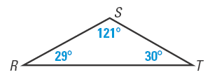
6.5 Indirect Proof and Inequalities in One Triangle
Big Angle Opposite Big Side Theorem
If one side of a triangle is longer than another side, then the angle opposite the longer side is larger than the angle opposite the shorter side.
Big Side Opposite Big Angle Theorem
If one angle of a triangle is larger than another angle, then the side opposite the larger angle is longer than the side opposite the smaller angle.
List the sides in order from shortest to longest.
Try #16
Notes:
ST, RS, RT

Slide 38
6.5 Indirect Proof and Inequalities in One Triangle
Draw a triangle with sides 5 cm, 2 cm, and 2 cm.
Draw a triangle with sides 5 cm, 2 cm, and 3 cm.
Draw a triangle with sides 5 cm, 3 cm, and 3 cm.
Triangle Inequality Theorem
The sum of two sides of a triangle is greater than the length of the third side.
AB + BC > AC; AB + AC > BC; BC + AC > AB
Notes:
Can’t be done, short side don’t touch
Can’t be done, forms a line
Can be done, isosceles triangle

Slide 39
6.5 Indirect Proof and Inequalities in One Triangle
A triangle has one side of 11 inches and another of 15 inches. Describe the possible lengths of the third side.
Try #20, 24
Notes:
$$11+x>15→x>4$$
$$15+x>11→x>−4 (already part of x>4)$$
$$11+15>x→26>x$$
Combine 1st and 3rd: 4 < x < 26
Short cut: subtract to get smallest, add to get largest

Slide 40
6.6 Inequalities in Two Triangles
After this lesson…
• I can explain the Hinge Theorem.
• I can compare measures in triangles.
• I can solve real-life problems using the Hinge Theorem.

Slide 41
6.6 Inequalities in Two Triangles
See Mr. Wright’s demonstration with the meter sticks.
How does the third side compare when there is a small angle to a big angle?
Notes:
Use two meter sticks to demonstrate the Hinge Theorem
Have two meter sticks form two sides of the Δ and have the kids imagine the third side.

Slide 42
6.6 Inequalities in Two Triangles
Hinge Theorem
If 2 sides of one Δ are congruent to 2 sides of another Δ, and the included angle of the 1st Δ is larger than the included angle of the 2nd Δ, then the 3rd side of the 1st Δ is longer than the 3rd side of the 2nd Δ.
10
15
40°
60°

Slide 43
6.6 Inequalities in Two Triangles
Converse of the Hinge Theorem
If 2 sides of one Δ are congruent to 2 sides of another Δ, and the 3rd side of the first is longer than the 3rd side of the 2nd Δ, then the included angle of the 1st Δ is larger than the included angle of the 2nd Δ.
10
15
40°
60°

Slide 44
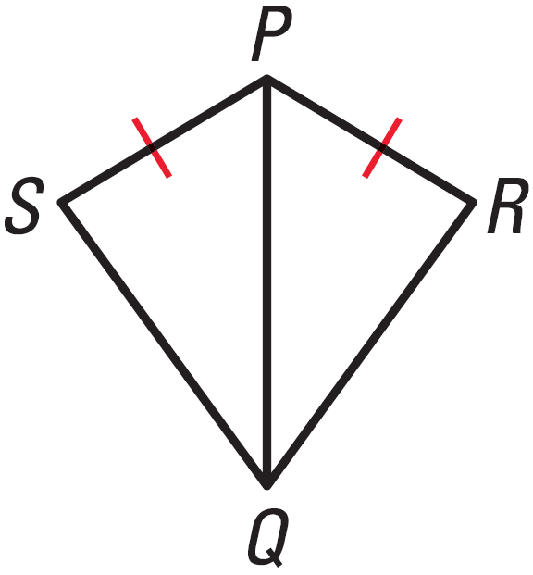

6.6 Inequalities in Two Triangles
If PR = PS and m∠QPR > m∠QPS, which is longer, $\overline{SQ}$ or $\overline{RQ}$?
If PR = PS and RQ < SQ, which is larger, m∠RPQ or m∠SPQ?
Try #2, 6

Slide 45

6.6 Inequalities in Two Triangles
Given: $\overline{AB}≅\overline{BC}, AD>CD$
Prove: $m∠ABD>m∠CBD$
Statements
Reasons
Try #10
Notes:
$\overline{AB}≅\overline{BC}, AD>CD$ (given)
$\overline{BD}≅\overline{BD}$ (Reflexive)
$m∠ABD>m∠CBD$ (Converse of Hinge Theorem)

Slide 46
6.6 Inequalities in Two Triangles
Two groups of joggers leave the same starting location heading in opposite directions. Each group travels 2 miles, then changes direction and travels 1 mile. Group A starts due north then turns 35° toward west. Group B starts due south then turns 25° toward east. Which group is farther from the start location? Explain your reasoning.
Try #12
Notes:
Group B; The measure of the included angle for Group B is 155°, which is greater than the measure of the included angle for Group A. So, Group B is farther from camp.

